Slide 1
SOFTWARE DEVELOPMENT MODELS COMPARISON:
HOW TO CHOOSE THE RIGHT ONE?

Slide 2
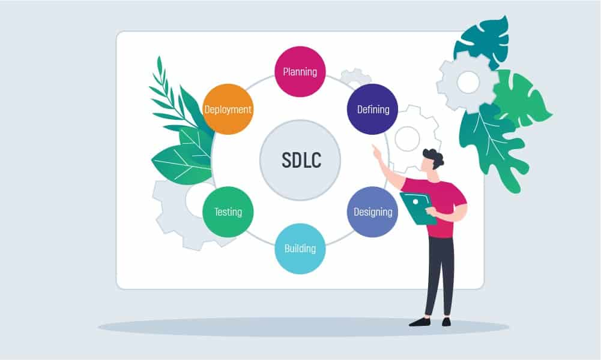

Slide 3
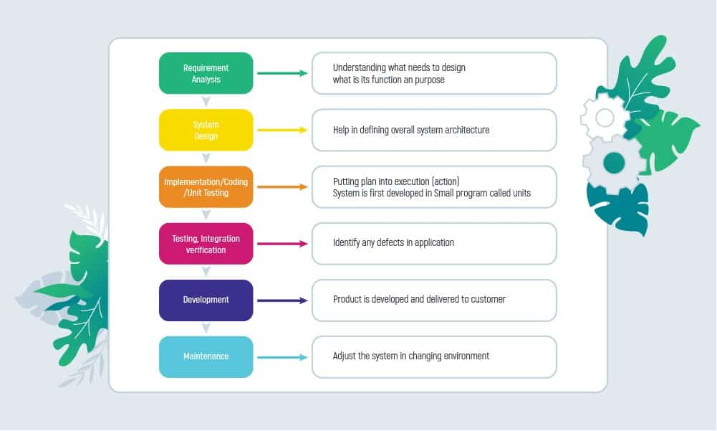
Waterfall Model

Slide 4
What factors contribute to choosing the Waterfall approach?
Short-term projects
Clear, fixed, and well-documented requirements
Static technology that is understood
Stable product definition
A variety of resources for product support
Low Product Owner Involvement
Strictly-set timeline
Fixed budget that cannot be changed

Slide 5
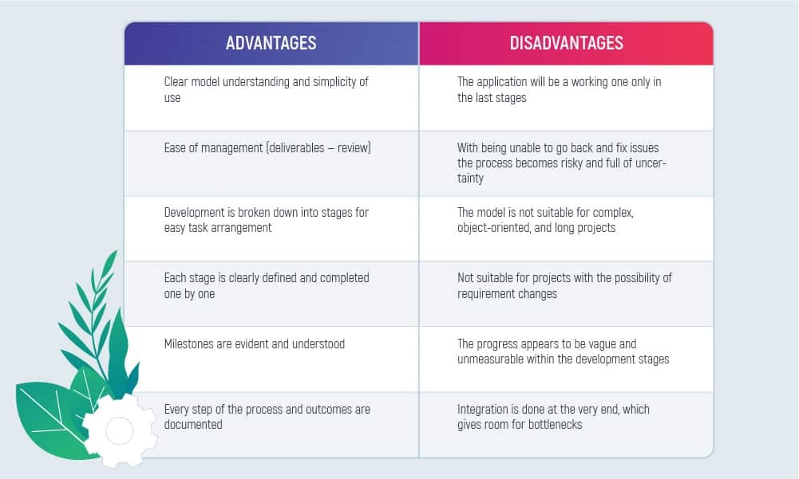

Slide 6
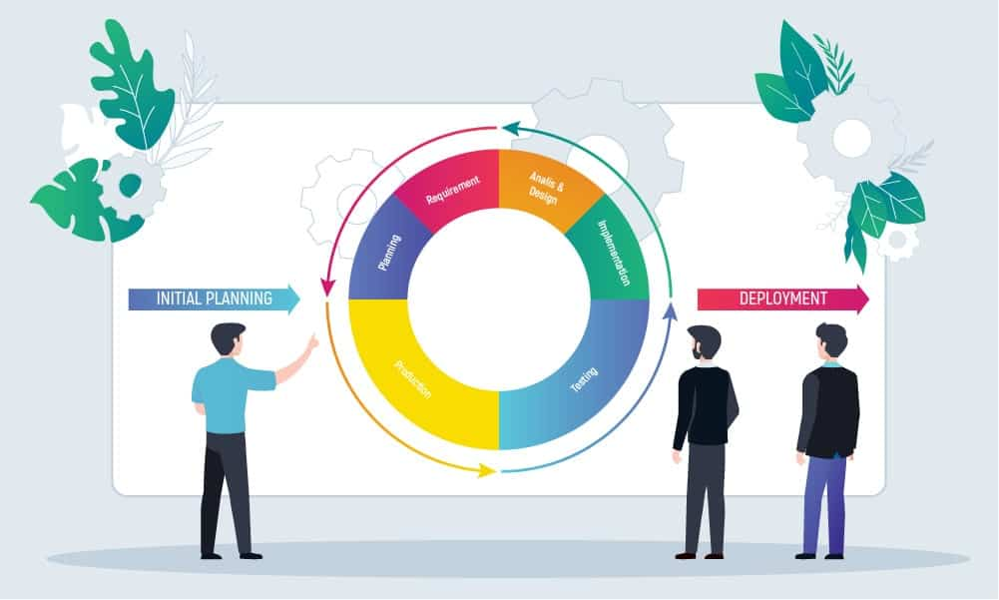
Incremental Model

Slide 7
Where is the Incremental Model applicable in software development?
System requirements are clearly defined and fully understood
Additional requirements can occur with time
When the team learns new technology and works on the project simultaneously
Specific resources are to be used only when they are required for specific iterations according to the contract
When the business goals might change in the future due to high-risk features

Slide 8
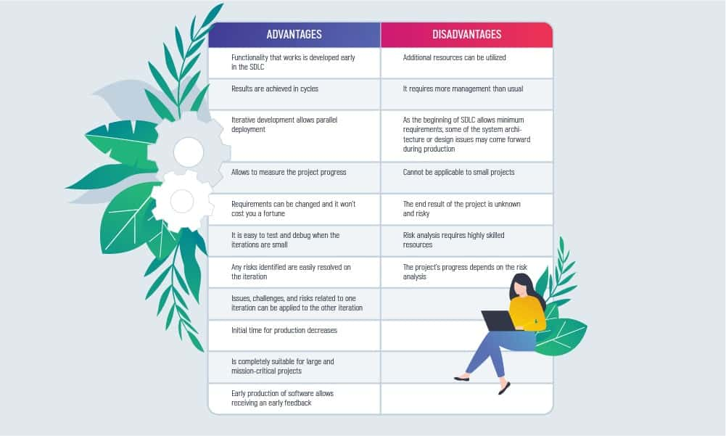

Slide 9
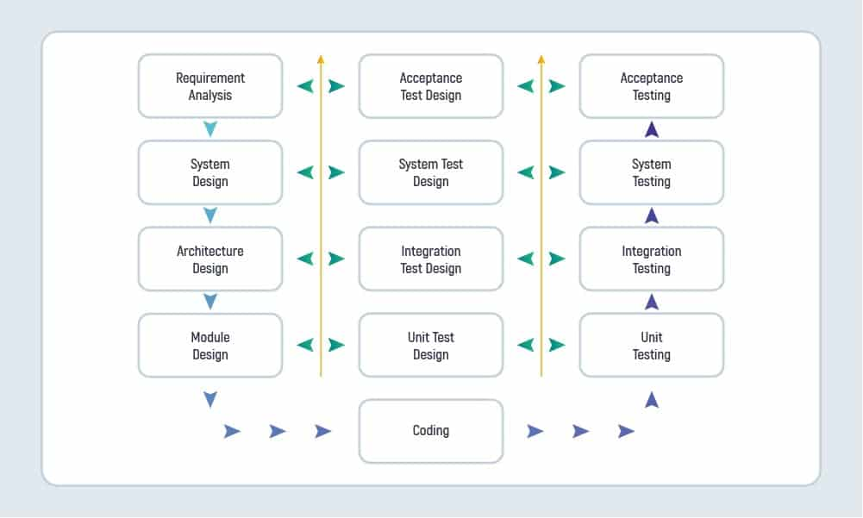
V-shaped Model

Slide 10
When to implement the V-Shaped Model?
There are clearly defined, documented, and stable requirements
The technology used is also stable and the project team has a full understanding of it
All of the requirements are extra clear
The project is short-term and not complex

Slide 11
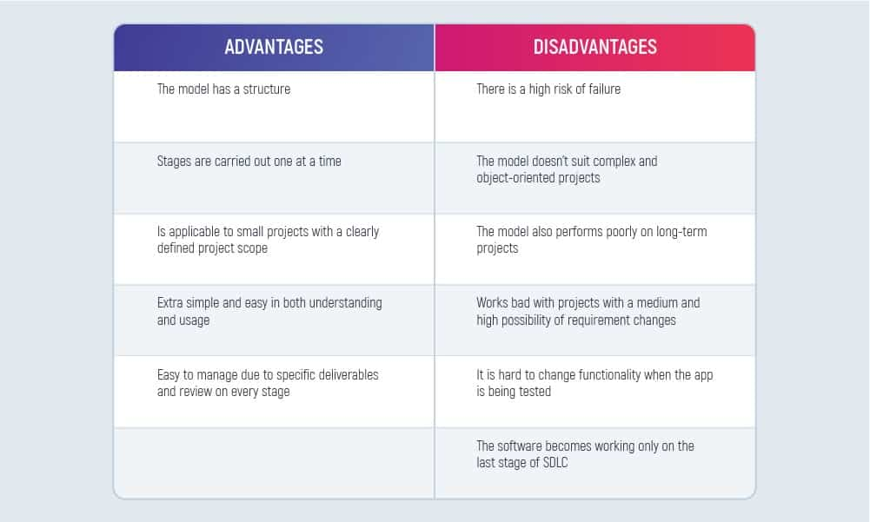

Slide 12
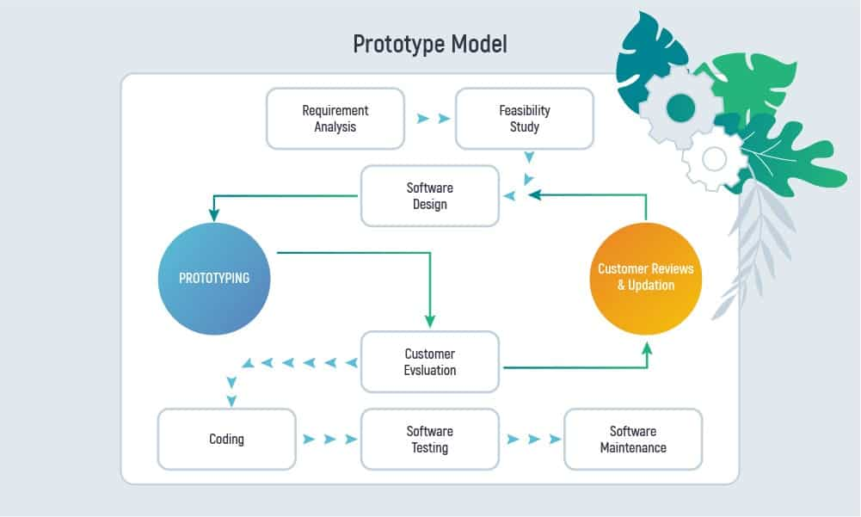
Prototype Model

Slide 13
Where and when is the Prototyping Model applicable?
Prototyping is applicable to online software system development where there is a high level of user interaction. For example,
Systems that require users to fill out forms
Software that requires lots of data processing

Slide 14
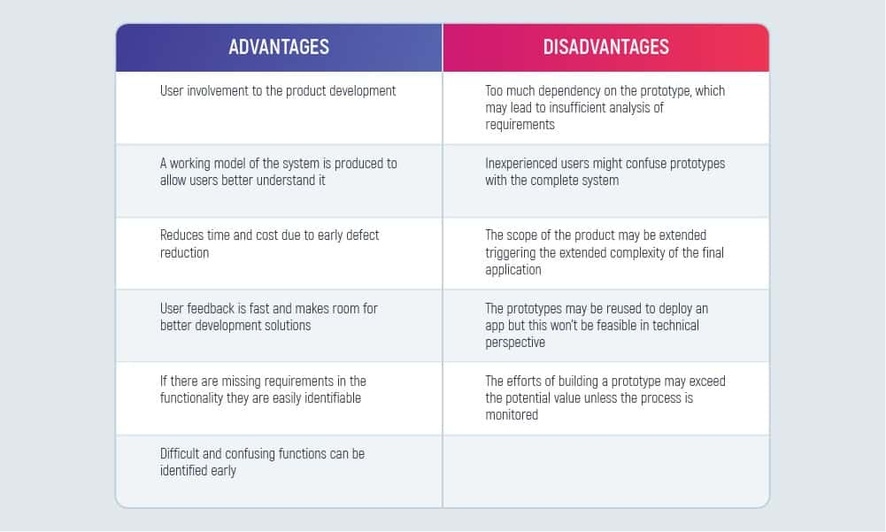

Slide 15
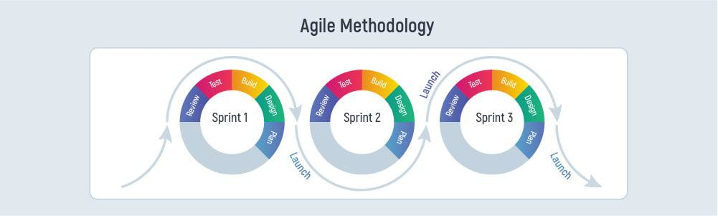
Agile Model

Slide 16
When can we use the Agile Methodology?
In small to medium-sized software projects
To produce the required multiple variants of the product
When you need to break down the development process into smaller parts – iterations
When there’s a need for software delivery acceleration
When the team needs to be flexible in changing priorities
When the need is to enhance software quality, productivity, and predictability in delivery
To promote project risk reduction and achieve cost reduction possibilities
To manage the distributed teams effectively on the project

Slide 17
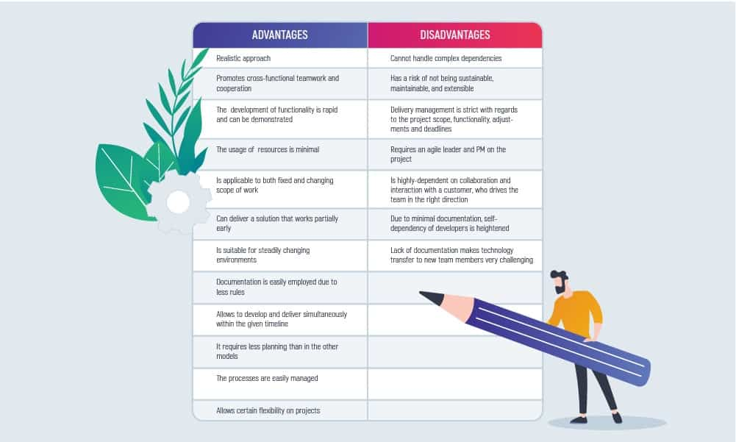

Slide 18
How to choose the SDLC Model that will suit you best?
There is no right or wrong software development model if you approach the process of choosing one with several important steps.
Step 1: Look through all the existing software development models to understand which one is closer to your beliefs and principles as well as business needs.
Step 2: Are there any needs of Stakeholders you should listen to first? Hear out every stakeholder as they can make a difference to your final decision.

Slide 19
Step 3: Think about the acceptance criteria and try to answer the following questions:
Is the model suitable for the size of the team and their skills?
Is the model suitable for the technologies used in the project?
Is the model suitable for both the client and the stakeholders?
Is the model suitable for the project size and its complexity?
Is there a project risk if we choose this model?
Are there going to be any changes in the process of product development?
Are the requirements fixed or flexible and may emerge during production?
Step 4: Decide which model fits your intentions
Step 5: Optimize the model according to your project
Now, as you have acknowledged all the project development nuances and found the model that will make a performance boost – select it and proceed with the product development.

Slide 20
Examples of various software developed using different process models:
Waterfall model was used to develop enterprise applications like Customer Relationship Management (CRM) systems, Human Resource Management Systems (HRMS), Supply Chain Management Systems, Inventory Management Systems, Point of Sales (POS) systems for Retail chains etc.
Typically, online systems, web interfaces have a very high amount of interaction with end users, are best suited for Prototype model. It might take a while for a system to be built that allows ease of use and needs minimal training for the end user.
WhatsApp, Windows, MS Office all are the examples of incremental model as day to day requirements change people want something better so they again analyse the requirement and repeat the SDLC process

Slide 21
V-model example: embedded system for elevator, military projects etc. A good example of the V-model used in the automotive software realm is the ECU development process as outlined by D-Space 10. In the automotive industry, it is common to test how a specific module of a system will function when possibly a number of the other components of the system (both hardware and software) have not been built yet.
Example of Software delivered using agile methodology :
Siemens Teamplay applications for medical software
The UK Government (HMRC) tax platform
Network International’s payment gateway
Netflix systems
Spotify systems

